Slide 1
URINARY BLADDER
DR OSO O.A

Slide 2
INTRODUCTION
The urinary bladder is a muscular reservoir of urine
The bladder is the most anterior element of the pelvic viscera
Although the bladder is considered to be pelvic in the adult. It has a higher position in children
At birth, the bladder is almost entirely abdominal. With age, the bladder descends until after puberty when it assumes the adult position

Slide 3
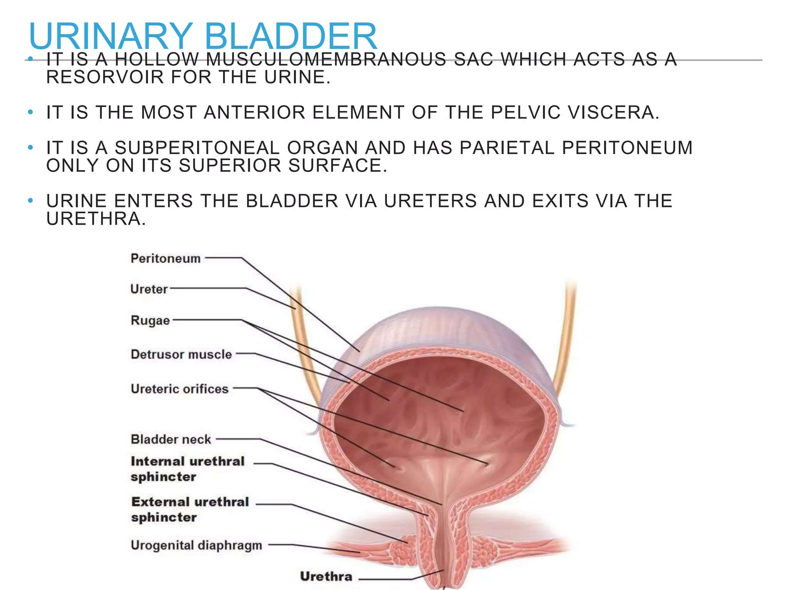

Slide 4
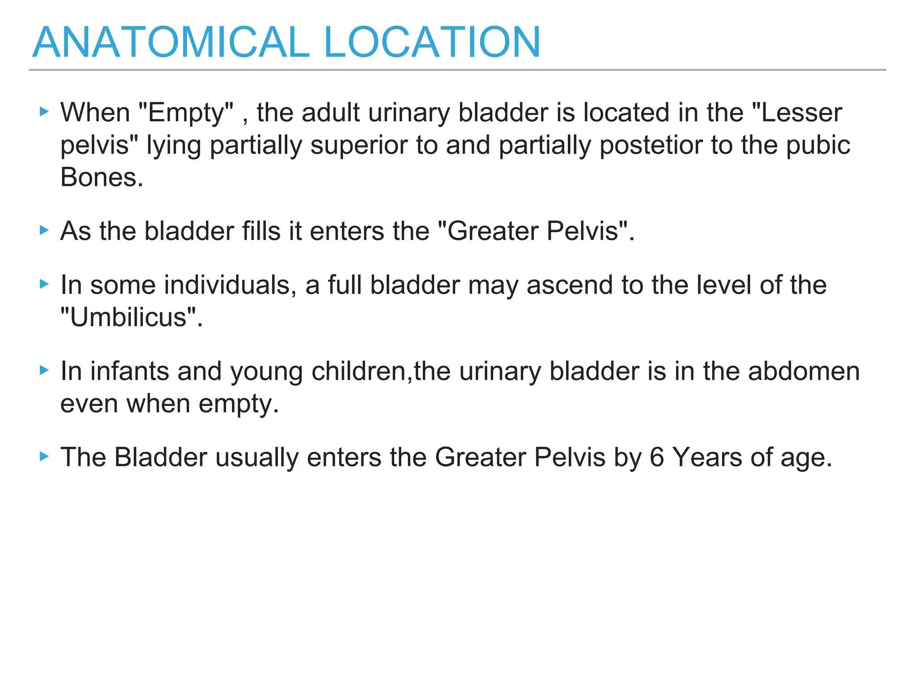

Slide 5
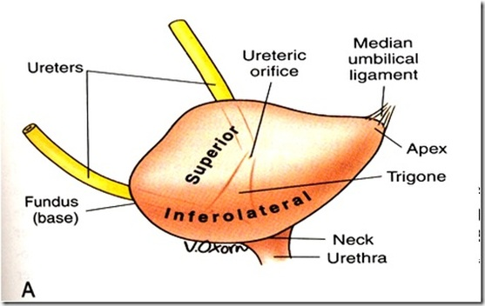
GROSS ANATOMY OF THE BLADDER
The empty bladder is shaped like a three-sided pyramids
It has an apex, base, superior surface, and two inferolateral surfaces
The apex of the bladder is directed toward the top of the pubic symphysis
The base is shaped like an inverted triangle and faces posteroinferiorly.

Slide 6
GROSS ANATOMY OF THE BLADDER
The inferolateral surfaces are cradled between the levator ani muscles of the pelvic diaphragm and the adjacent obturator internus muscle above the attachment of the pelvic diaphragm
The superior surface is slightly domed when the bladder is empty. It balloons upward as the bladder fills

Slide 7
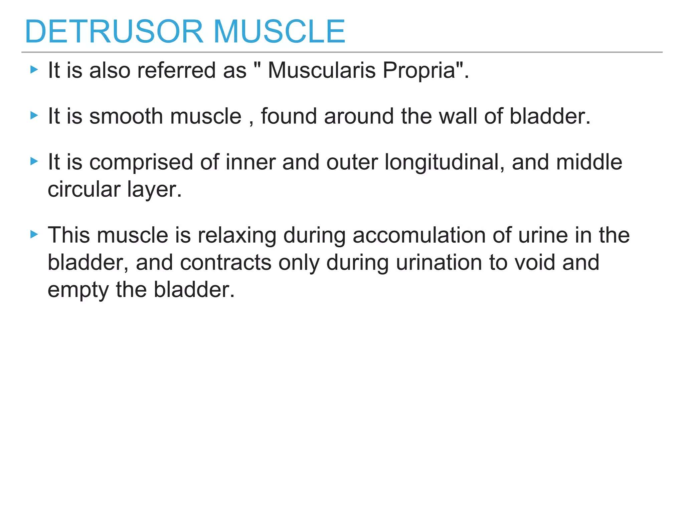

Slide 8
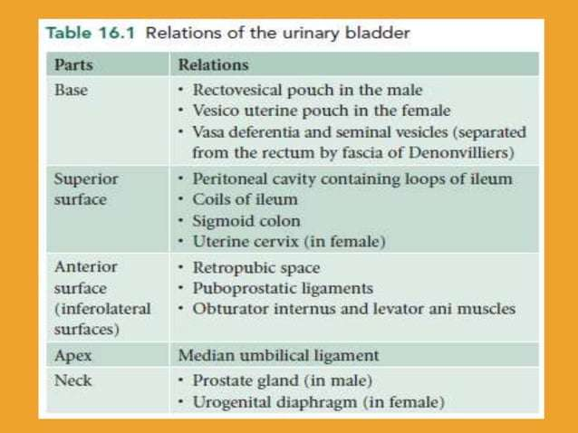

Slide 9
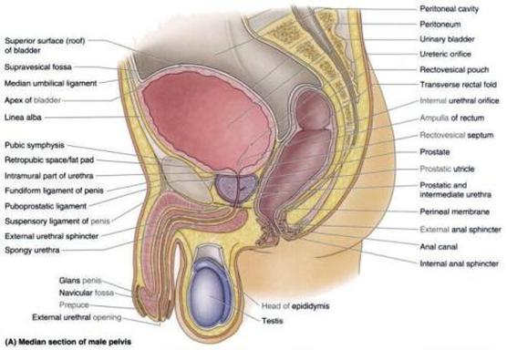
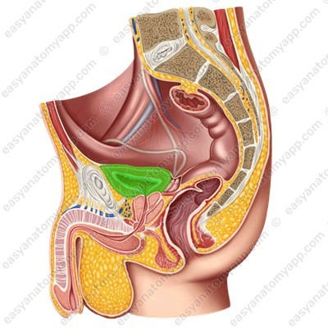
Relations of the urinary bladder

Slide 10
INTERIOR OF THE URINARY BLADDDER
The triagone, ureteric orifices, inter ureteric crest, uvula of the bladder, internal urethral meatus
The two ureters enter the bladder at each of the upper corners of the base and the urethra drains inferiorly from them the lower corner of the base
The mucosal lining on the base of the bladder is smooth and firmly attached to the underlying smooth muscle coat of the wall unlike elsewhere in the bladder where the mucosal is folded and loosely attached to the wall
The smooth triangular area between the openings of the ureters and urethra on the inside of the bladder is known as the trigone

Slide 11
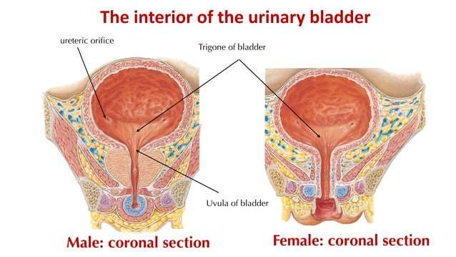

Slide 12
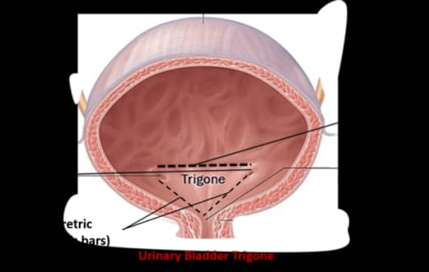

Slide 13
NECK OF BLADDER
The neck of the urinary bladder surrounds the origin of the urethra at the point where the two inferolateral surfaces and the base intersect
The neck is the most inferior part of the bladder and also the most fixed part. It is anchored into position by a pair of tough fibromuscular bands
In women, the fibromuscular bands are termed pubovesical ligaments and in men is termed puboprostatic ligaments. The ligaments help support the bladder

Slide 14
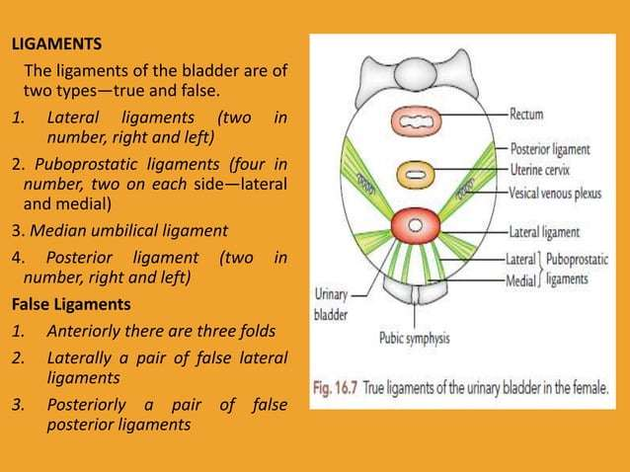

Slide 15


Slide 16
CLINICAL ANATOMY
Bladder stones
Suprapubic Catheterization
Bladder cancer

Slide 17
THANK YOU

